Slide 1
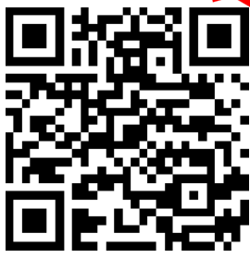
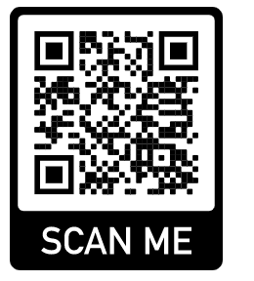
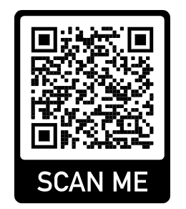
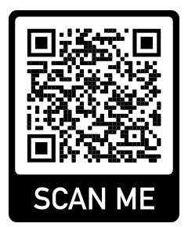
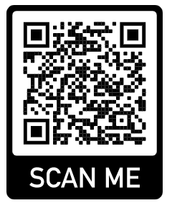
Family Business Library
Rural and Regional Libraries as Local Family Entrepreneurship centres Project Number: 2020-1-LV01-KA204-077548
Erasmus+ Project FBL
The ERASMUS+ project Family Business Library aims to promote entrepreneurship education in non-urban and rural regions. The core idea of the project is to address people in rural regions via local and regional libraries.
A special focus in the activities is the promotion of family business creation and local entrepreneurship. A main aspect of the approach is to use regional and rural libraries as a platform to reach people and the local population.
The six project partners: Latvia, Germany, Croatia, Italy, and Greece.
The Coordinator is ArtSmart from Latvia.
Scan the QR code
Please visit our website for more information
The European Commission support for production of this publication does not constitute an endorsement of the contents which reflects the view only of the authors and the Commission can not be held responsible for any use which may be made of therein.

